Slide 1
Business and Industrial Economics
Prof. Luca Grilli
Asymmetric Information

Slide 2
Asymmetric Information in Markets
In purely competitive markets all agents are fully informed about traded commodities and other aspects of the market. Imperfectly informed markets with one side better informed than the other are markets with asymmetric information. Examples:
- A doctor knows more about medical services than does the buyer.
- An insurance buyer knows more about his riskiness than does the seller.
In what ways can asymmetric information affect the functioning of a market?
2 problems (2 type of remedies):
Adverse selection
Moral hazard
Signaling [remedy]
Incentives [remedy]
Final Remarks

Slide 3
Adverse Selection (Akerlof 1970, QJE)
Consider a used car market: 100 people want to sell their used car; 100 people want to buy.
Two types of cars; “lemons” and “plums”. Everyone knows that 50 of the cars are plums, 50 are lemons.
Each lemon seller will accept $1,000; a buyer will pay at most $1,200.
Each plum seller will accept $2,000; a buyer will pay at most $2,400.

Slide 4
Adverse Selection
Suppose quality of the cars can be verified.
If every buyer can tell a plum from a lemon, then lemons sell for between $1,000 and $1,200, and plums sell for between $2,000 and $2,400.
N.B. Gains-to-trade are generated when buyers are well informed.

Slide 5
Adverse Selection
Suppose that now quality can not be verified: no buyer can tell a plum from a lemon before buying.
What is the most a buyer will pay for any car?

Slide 6
Adverse Selection
Varian, p. 741: “…..The buyers have to guess about how much each car is worth. We’ll make a simple assumption about the form that this guess takes: we assume that if a car is equally likely to be a plum as a lemon, then a typical buyer would be willing to pay the expected value of the car. Using the numbers described above this means that the buyer would be willing to pay”:
EV: (1/2)* 1200 + (1/2)* 2400 = $1800.
Assumption of neutrality to risk: WTP = EV (if risk-aversion WTP < EV)
EV = Prob_{lemons}*WTP_{lemons}+ Prob_{plums}*WTP_{plums}

Slide 7
But who would be willing to sell their car at that price?
The owners of the lemons certainly would
The owners of the plums certainly not: they need at least $2000 to part with their cars.
N.B. At a price of $1800 only lemons would be offered for sale

Slide 8
Adverse Selection: Conclusions
No plums are sold
Consumers soon realize that only lemons are sold
They revise their expectations (lemons prob. = 1; plums prob. = 0)
Lemons are the only cars sold: the equilibrium price will be somewhere in-between $1000 and $1200.
Even though the price at which buyers are willing to buy plums exceeds the price at which sellers are willing to sell them, no such transactions will take place.

Slide 9
In the used car market, producers do not choose endogenously whether to have “plums” or “lemons”. But note that adverse selection may also occur when producers do have the option to produce low-quality or high-quality goods and face different costs for producing the two (see Appendix 1 taken from Varian)

Slide 10
Exam multiple choice question

Slide 11
Asymmetric information
Adverse selection is a problem of hidden information
But we have a second problem originated by asymmetric information: moral hazard. This is caused by an hidden action problem

Slide 12
Moral Hazard
Moral hazard in a transaction occurs when the party with more information about its actions or intentions has a tendency or incentive to behave inappropriately from the perspective of the party with less information.
Let’s focus on the insurance Mkt:
If one has full bike insurance what are the probabilities that he will leave the bike unlocked?

Slide 13
Moral Hazard
1) Suppose no insurance is available
Consumers have an incentive to take the maximum possible amount of care (large expensive locks, avoiding go in high-risk areas, etc.)
2) Suppose a full insurance is available
Consumers have no incentive to take any care. In case of theft, they can get money from the insurance company and buy a brand new bike. This lack of incentive to take care is what is called MORAL HAZARD.

Slide 14
Moral Hazard: NOTEs
1) Moral hazard is a hidden action problem: if the amount of care is observable, there would be no problem.
2) The insurance company faces a trade-off: full insurance (higher immediate returns) means too little care will be undertaken by ensured (higher risk of bearing great costs later).
3) Where is the market inefficiency here?
The possibility that moral hazard might occur can lead to less trade than the optimum
Consumers may want to buy more insurance, and the insurance companies would be willing to provide more insurance if the consumers continued to take the same amount of care . . . but this trade won’t occur because if the consumers were able to purchase more insurance they would rationally choose to take less care!

Slide 15
Asymmetric Information: remedies

Slide 16
In the example of the used cars market
Signaling
Plums sellers may use warranties.
A warranty (of let’s say 1,500$) if the car breaks down can be convenient only for plum sellers (good cars do not break down very often), while it could not be replicable by lemons sellers pretending to be sellers of good cars (their lemons break down very often).
The “good” is now distinguishable from the “bad”.
In fact, adverse selection is an outcome of an informational deficiency.
The remedy is to act on information and find a way through which high-quality sellers may signal credibly that they are high-quality.
E.g. warranties, professional credentials, references from previous clients, etc.

Slide 17
Signaling (Spence, 1974, “Job Market Signaling”, QJE)
A labor market has two types of workers: high-ability and low-ability.
A high-ability worker’s marginal product is a_{H}.
A low-ability worker’s marginal product is a_{L}.
a_{L} < a_{H}.

Slide 18
Signaling
A fraction h of all workers are high-ability.
1 - h is the fraction of low-ability workers.
Each worker is paid his expected marginal product.
If firms knew each worker’s type they would:
pay each high-ability worker w_{H} = a_{H}
pay each low-ability worker w_{L} = a_{L}.

Slide 19
Signaling
If firms cannot tell workers’ types then every worker is paid the (pooling) wage rate; i.e. the expected marginal product:
w_{P} = (1 - h)a_{L} + ha_{H}.
As long as the good and the bad workers both agree to work at this wage (and high ability workers maintain their high level of productivity) there is no problem with adverse selection in the eyes of the firm.
But suppose the firm fears that the pooling wage scheme may depress high-ability workers and be detrimental to its profit and therefore it is very much willing to look for a separating equilibrium: w_{H} = a_{H} and w_{L} = a_{L}

Slide 20
Signaling: 2 questions
How can this separating equilibrium be achievable? If w_{H} and w_{L} is the wage scheme offered, how is possible to select the “right” types of workers for the “right” wage?
How is it possible for high-ability workers being selected for w_{H} and not w_{L}? How can they credibly demonstrate their nature?

Slide 21
Signaling
SIGNAL: a costly method available to signal you are a good type such that the cost of signaling is too high for bad types that they won't do it
Michael Spence, Market Signaling (Cambridge, Mass: Harvard University Press,1974)
Besides being costly, of course signals should be observable (Connelly et al. 2011, JoM, vol. 37, 39-67).

Slide 22
Signaling
Workers can acquire “education”.
Education costs a high-ability worker c_{H} per unit and costs a low-ability worker c_{L} per unit.
c_{L} > c_{H}.
Suppose that education has no effect on workers’ productivities (extreme assumption, just to make the point and make it simple, obviously this should not be necessarily true in real life): i.e., the cost of education is a deadweight loss.

Slide 23
Signaling
High-ability workers will acquire e_{H} education units if (i) w_{H} - w_{L} = a_{H} - a_{L} > c_{H}e_{H}, and (ii) w_{H} - w_{L} = a_{H} - a_{L} < c_{L}e_{H}.
(i) says acquiring e_{H} units of education benefits high-ability workers.
(ii) says acquiring e_{H} education units hurts low-ability workers.

Slide 24
Signaling
and
together require
Acquiring such an education level credibly signals high-ability, allowing high-ability workers to separate themselves from low-ability workers.
P.S.: how much education should low-ability workers acquire (in this very simplified framework)? Zero. Given that acquiring e_{H} units is not convenient for them, they will be paid w_{L} = a_{L} in any case, even if they acquire a lower level of education (say e_{L}).

Slide 25
Example of exam question

Slide 26
Signaling: Note
Signaling can improve information in the market. But it involves a cost, and for this reason, the equilibrium is sub-optimal with respect to a full information scenario.
If the pooling equilibrium is accepted by high-ability workers (and does not affect their high productivity) total output does not change. Education is costly so signaling may hurt market’s efficiency: to some extent resources are wasted in order to enforce a separating equilibrium (high-ability workers would have preferred to be recognizable as such without the need to “signal”).

Slide 27
What’s the role of Government in signaling?
Limited but with one notable exception
Asymmetric Information
-
Search goods (no Asymmetric Info)
Experience goods (Asymmetric Info only ex-ante)
Credence goods (Asymmetric Info ex-ante but also ex-post)
+

Slide 28
In the example of the full bike insurance
Incentives
The insurance companies generally never offer the consumers “complete” insurance. They will always want the consumer to face some part of the risk. This is why they usually include a “deductible,” an amount that the insured party has to pay in any claim. By making the consumers pay part of a claim, the insurance companies can make sure that the consumer always has an incentive to take some amount of care.
The buyer is incentivized

Slide 29
Hidden action (moral hazard)
Incentives
Principal-agent theory

Slide 30
Principal-agent theory (Agency theory)
Area of economics that deals with all situations where there is a principal who wants an agent to act in the principal’s interest to achieve some goal.
When the principal possesses less information than the agent, the two have different objective functions, principal can not monitor perfectly agent’s behavior and resulting performance of agent’s action is noisy.
Principal-agent problem
In such situations, the agent can indulge in moral hazard, but proper incentives set by the principal, by re-aligning objective functions between the two, can help mitigate the problem

Slide 31
Full info scenario
Appoint
Effort
Principal
Agent
Performance (only a function of effort)
CAN MONITOR
WAGE works perfectly. Why?
Less Performance
Less Effort
Less money for the agent
Principal is 100% sure
Hidden action scenario
Appoint
Effort
Performance (now not only a function of effort, but also randomness and unverifiable circumstances)
Principal
Agent
CAN NOT MONITOR
Is WAGE salary working well now?
Less effort?
Less money for the agent? Difficult to enforce: agent becomes indifferent of the poor performance
Less Performance
Undetectable

Slide 32
Flexible remuneration schemes
How the principal can mitigate the problem?
Choosing another form of remuneration, making the “agent” participate to the sharing of the performance (i.e. part of the agent’s salary depends on the final performance)
Sharecropping in agriculture
Stock options for managers in public companies
Many corporations are owned by a large number of small shareholders. This considerably decreases the incentives for each single shareholder to monitor the behavior of managers: the effort necessary is very high compared to the benefit. Board of directors only partly defend shareholders, and managers are better informed anyway.
Managers may pay shareholders and retain all the profits (become owners)
Fixed salary
Management buyout
Mitigate managers’ risk-aversion
Could be a solution if managers are not risk-averse and are not subject to financial constraints
Still incentivize managers
Normally contracts foresee a combination of fixed wage and profit-contingent compensation.

Slide 33
Incentives: note
Incentives may make objective functions of the 2 sides more similar but not the same, so behavior/effort of the more informed party (the “agent”) is unlikely to be the one that would be optimal in a full info scenario. Sharecropping: the farmer only benefits for a fraction of the harvest, s/he will exert some effort in the interest of the “principal”, but this effort is unlikely to be as high as the effort s/he would exert in case s/he own the land her/himself.
(Appendix 2 from Varian shows this rather intuitive result in a formal way)

Slide 34
FINAL REMARKS

Slide 35
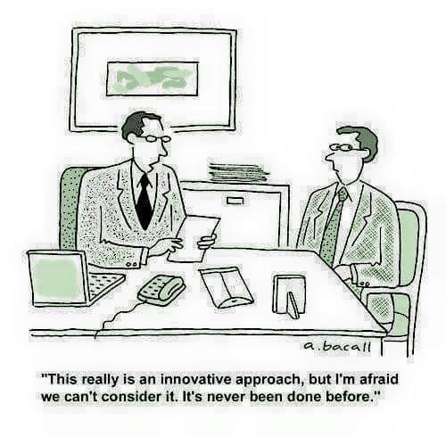
Problems (and partial remedies) in the market for finance of innovation (especially for start-ups)

Slide 36
Adverse selection Mkt for FINANCE of INNOVATION
There are good and bad innovation projects (bad projects = high risk of failure);
Those who provide external finance (i.e. banks) can not perfectly discern good vs. bad projects, and generally proponents could be more informed about odds of success.
To shield from the risk, banks pose average (unfavorable) conditions for lending to everybody (i.e. high interest rates or credit-rationing).
Only (often low-skilled and high-risk loving) “kamikaze” innovators will ask for money while capable innovators (those with sufficiently good quality but at the same time realistic projects) may prefer to give up searching for external debt finance (discouraged borrowers) or search for other alternative financing sources.
Good innovation projects may risk not to be financed.

Slide 37
Moral Hazard Mkt for FINANCE of INNOVATION
For an outsider (external investors) may be difficult to monitor the strategies, choices, decisions taken by innovative managers and entrepreneurs.
Innovative managers and entrepreneurs may put in place actions not in the interest of the investors, or that investors would not have agreed (e.g. divert funds to different aims, exert less effort than required).

Slide 38
Signals & Incentives in Mkt for FINANCE of INNOVATION
(Sort of) “signals”
Established firms may exhibit their track record,
Innovative start-ups may show their goodness to external investors:
-patenting (Hsu and Ziedonis, 2013, SMJ),
-endorsement by a reputable alliance partner
(Stuart et al., 1999, ASQ; Stuart, 2000, SMJ).
(Sort of) “incentives”
- Banks: Use of collateral to secure debt.
- VC: “active investors” (i.e. work side by side with entrepreneurs), co-investment with entrepreneurs as a guarantee of high effort, use of milestones (staged rounds of financing).
Of course, these dimensions are not pure signals, but they may still have a signaling function

Slide 39
Education as a signal

Slide 40
Education as a signal

Slide 41

Incentives as “signals”
If signals are exogenously absent, firms may always endogenously look to put in place some incentive schemes in order to make workers’ type reveals (“signals”) themselves

Slide 42
Zappos (from Levitt & Dubner “Think like a freak”, 2014)
Zappos founded in 1999 in Las Vegas for selling shoes on-line
Management team: “customer obsessed culture”
Customer service: key asset.
365 day-return window, free-shipping, but in team’s view the Call centre 24/7 with no limits talking (“protracted talk therapy”, as one observer noted) would have been their core advantage.
A call-centre job isn’t typically very desirable, nor does it pay well (e.g. 11$ per hour)….How could they obtain that? Paying workers more was not an option
More fun & power for customer-service representatives

Slide 43
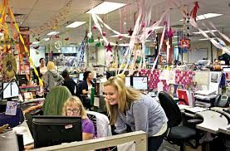
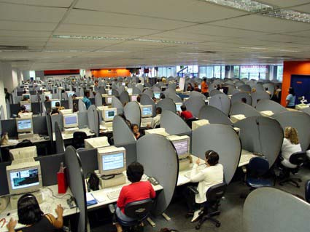
Where would you go more happily to work?

Slide 44
Zappos’s incentive
But Zappos management team needs to know early who really was engaged with the project and share its customer-centric obsession culture and who is not.
To escape from a pooling eq. to reach a separating eq. where good customer-service representatives are separated from bad ones, Zappos use the following incentive scheme:
From Levitt & Dubner (2014): “When new employees are in the on boarding period- they have already been screened, offered a job and completed a few weeks of training- Zappos offers them a chance to quit. Even better, quitters will be paid roughly 2000$ just for quitting”
This is the cost the firm and “good guys” are willing to suffer to implement a separating equilibrium.
Incidentally note:
Very few “ new hires” accepted “The Offer”.
“In 2009, Zappos was bought by Amazon.com for 1.2$ billion.”

Slide 45

Asymmetric Information
Digital Technologies (e.g. Internet and big data) may help reducing Asymmetric Info. But at which “price” from a societal point of view?

Slide 46
References
Varian (Intermediate Microeconomics, chapter 38).

Slide 47
Appendix 1: Adverse Selection with Quality Choice
Suppose that each seller can choose the quality, or value, of her product. In this market, there are no repeated purchases (i.e. no strong reputational gains or damages at stake).
Two umbrellas: high-quality and low-quality.
Which will be manufactured and sold?

Slide 48
Adverse Selection with Quality Choice
Suppose:
- Buyers value a high-quality umbrella at $14 and a low-quality umbrella at $8.
- Before buying, no buyer can tell quality.
- Marginal production cost of a high-quality umbrella is $11.
- Marginal production cost of a low-quality umbrella is $10.

Slide 49
Adverse Selection with Quality Choice
Suppose every seller makes only high-quality umbrellas.
- Every buyer pays $14 and sellers’ profit per umbrella is $14 - $11 = $3.
- But then a seller can make low-quality umbrellas for which buyers still pay $14, so increasing profit to $14 - $10 = $4.

Slide 50
Adverse Selection with Quality Choice
N.B. There is no market equilibrium in which only high-quality umbrellas are traded.
But…
Is there a market equilibrium in which only low-quality umbrellas are traded?

Slide 51
Adverse Selection with Quality Choice
All sellers make only low-quality umbrellas.
Buyers pay at most $8 for an umbrella, while marginal production cost is $10.
N.B. There is no market equilibrium in which only low-quality umbrellas are traded.

Slide 52
Adverse Selection with Quality Choice
Now we know there is no market equilibrium in which only one type of umbrella is manufactured.
Is there an equilibrium in which both types of umbrella are manufactured?

Slide 53
Adverse Selection with Quality Choice
A fraction q of sellers make high-quality umbrellas; 0 < q < 1.
Buyers’ expected value of an umbrella is
EV = 14q + 8(1 - q) = 8 + 6q.
High-quality manufacturers must recover the manufacturing cost:
EV = 8 + 6q ≥ 11 ⇒ q ≥ 1/2.

Slide 54
Adverse Selection with Quality Choice
So at least half of the sellers must make high-quality umbrellas for there to be a pooling market equilibrium.
But then a high-quality seller can switch to making low-quality and increase profit by $1 on each umbrella sold.
Since all sellers reason this way, the fraction of high-quality sellers will shrink towards zero -- but then buyers will pay only $8.
N.B. So there is no equilibrium in which both umbrella types are traded.

Slide 55
Adverse Selection with Quality Choice
The market has no equilibrium
with just one umbrella type traded
with both umbrella types traded
So the market has no equilibrium at all
Adverse selection has destroyed the entire market!

Slide 56
Appendix 2: Incentives and agent’s effort

Slide 57
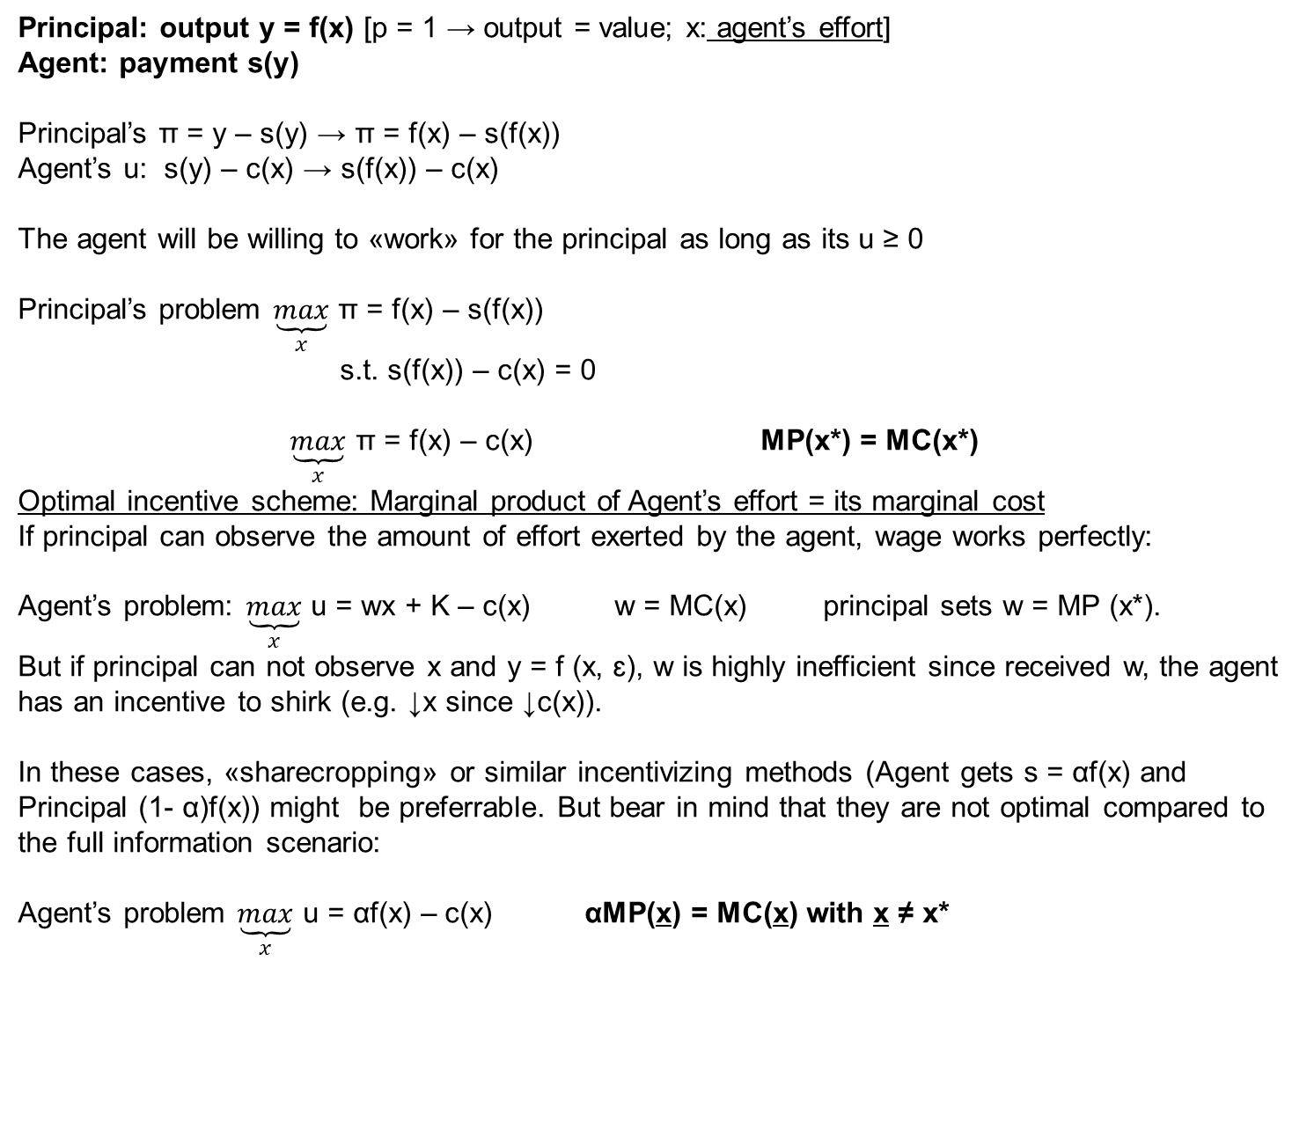
Facultative
Principal: output y = f(x) [p = 1 → output = value; x: agent’s effort]
Agent: payment s(y)
Principal’s π = y – s(y) → π = f(x) – s(f(x))
Agent’s u: s(y) – c(x) → s(f(x)) – c(x)
The agent will be willing to «work» for the principal as long as its u ≥ 0
Principal’s problem $\underset{x}{\underbrace{max}}$ π = f(x) – s(f(x))
s.t. s(f(x)) – c(x) = 0
$\underset{x}{\underbrace{max}}$ π = f(x) – c(x) MP(x*) = MC(x*)
Optimal incentive scheme: Marginal product of Agent’s effort = its marginal cost
If principal can observe the amount of effort exerted by the agent, wage works perfectly:
Agent’s problem: $\underset{x}{\underbrace{max}}$ u = wx + K – c(x) w = MC(x) principal sets w = MP (x*).
But if principal can not observe x and y = f (x, ɛ), w is highly inefficient since received w, the agent has an incentive to shirk (e.g. ↓x since ↓c(x)).
In these cases, «sharecropping» or similar incentivizing methods (Agent gets s = αf(x) and Principal (1- α)f(x)) might be preferrable. But bear in mind that they are not optimal compared to the full information scenario:
Agent’s problem $\underset{x}{\underbrace{max}}$ u = αf(x) – c(x) αMP(x) = MC(x) with x ≠ x*
Formal analysis, see Varian 2010, Ch. 37.7.
Incentives mitigate but do not solve the problem (x ≠ optimal x*)

